Slide 1
Project Assignment-2 ANP-C9180 ChiragSharma_AF0438100

Slide 2
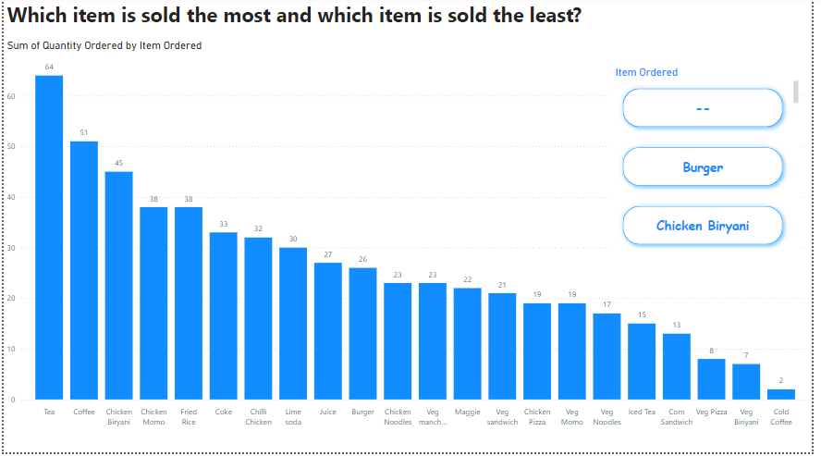
This is the Question 1. base on slicer we can see the order quantity by items base on that we take decision on which all items have high order rate or common order by people.

Slide 3
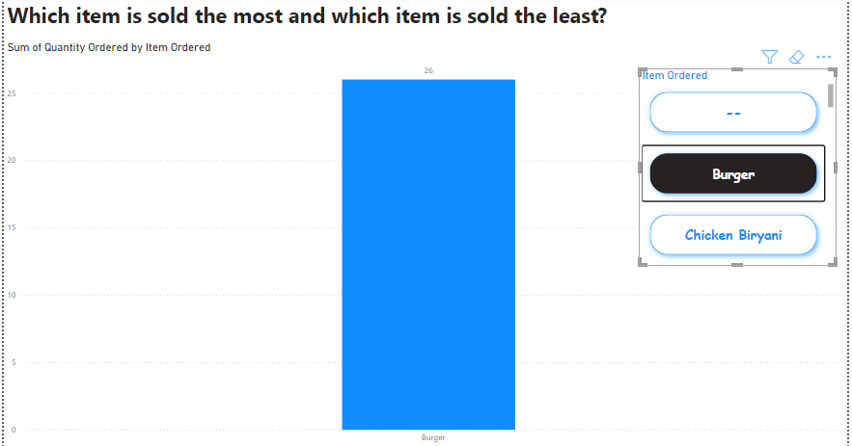
After using slicer for individual item how much is the order count

Slide 4
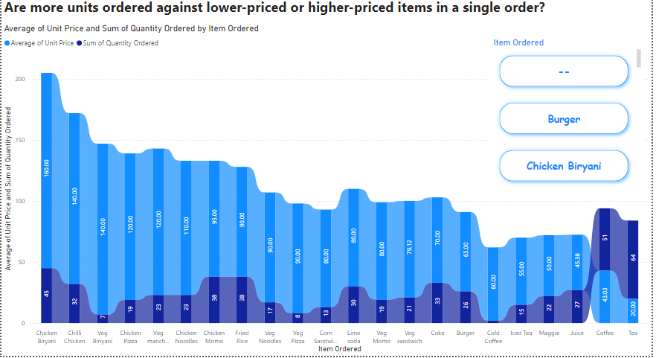
Question 2. Based on order of items we have find the average unit price based on this we can analyse that which items have high order rate with highly sold here there are some veg pizza and other veg items .
Based on that we can check in which time slot which all items have less order so we can remove that from that time slot.

Slide 5
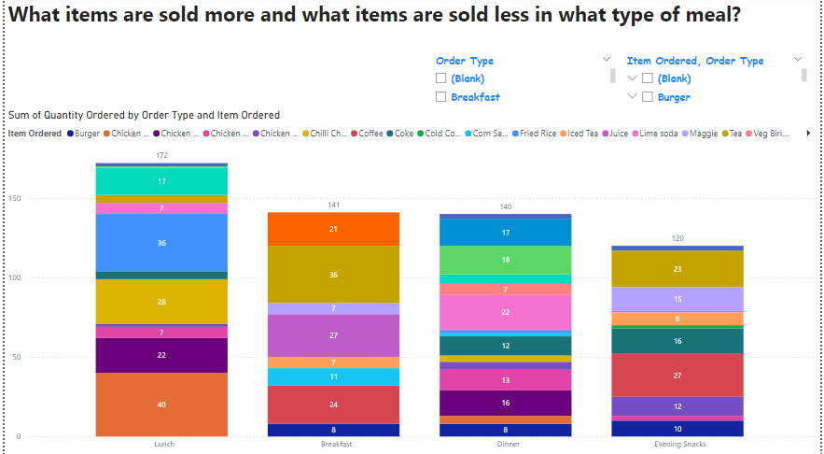
Question 3. Based on the order type in a day I have prepare this chart it will tell that in time slot which are items are most common that people have order so based on that will change the menu with the combo offer

Slide 6
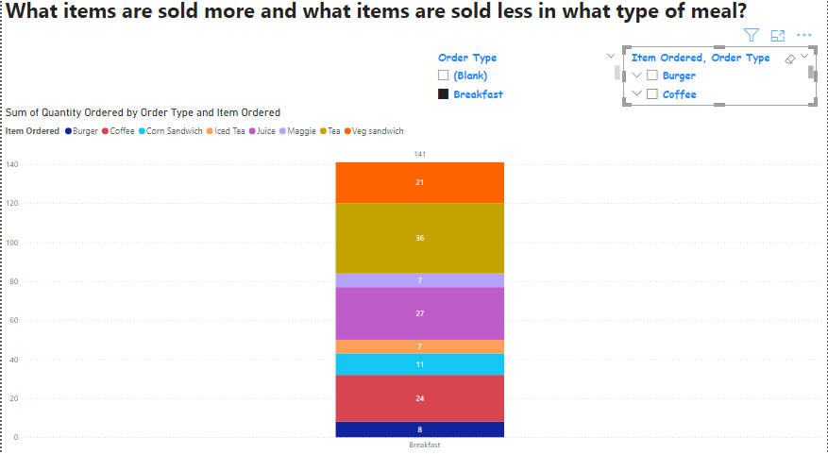
Question 3. Based on each time slot which has very less order that items get remove from the menu list.

Slide 7
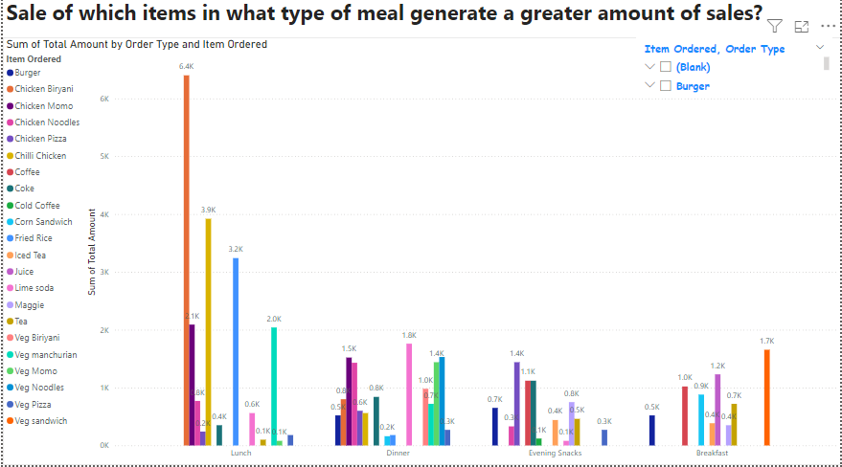
Question 4. based on data which are items have highly profitable on that items , we work more on it and remove that items which less common order or not give have high scales like Veg. pizza and there are other items also.

Slide 8
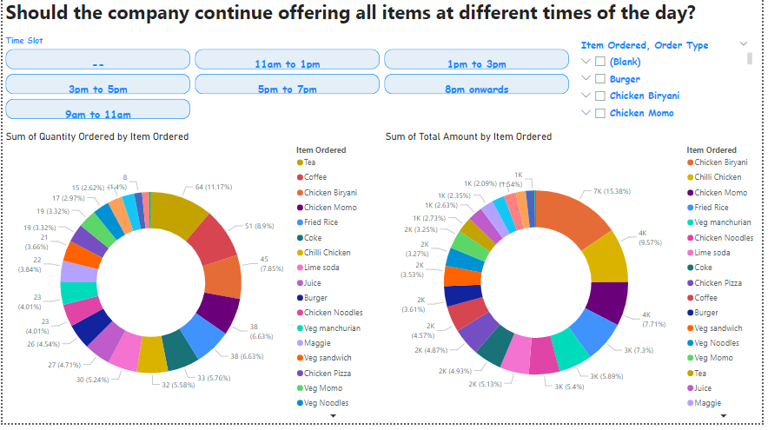
Question 5. based on time slot over all items list of there scales and there count of order.

Slide 9
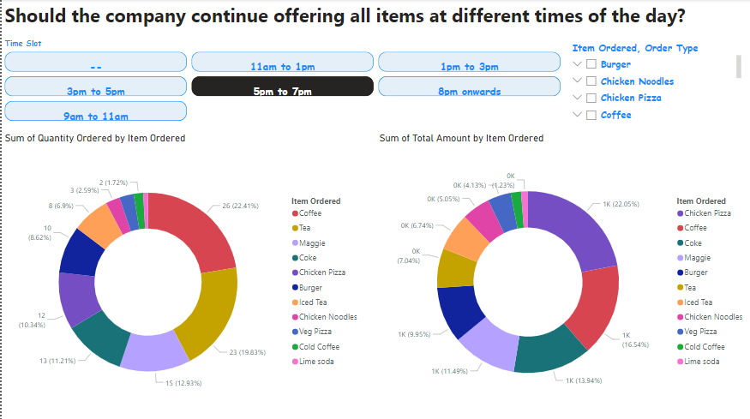
Inside this using slicer we can find which time slot which are the highly count orders of items has been ordered on bases of we can take decision we have keep that particular item into that time slot or not .

Slide 10
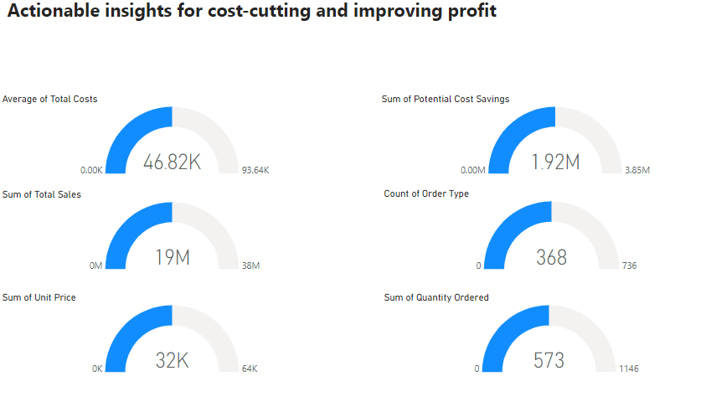
Question 6. inside this I have done overall profit and scale according to the data based on all the 6 question we will take the decision which items which should and which all we will not.

